Slide 1



Empowering
Social Buzz

Slide 2



Today's agenda
Project recap
Problem
The Analytics team
Process
Insights
Summary

Slide 3

Social Buzz, a burgeoning social media firm, seeks assistance for their upcoming IPO and the management of extensive data. The 3-month project will involve big data audits, IPO guidance, and content analysis. Accenture's focus will be on establishing trust and providing actionable insights for a lasting collaboration.
Project Recap
Big data audit, and understanding best practices.
IPO recommendations, content analysis.

Slide 4


Problem
Data Complexity:
Managing and analyzing vast amounts of unstructured data, including text, images, videos, and GIFs, can pose a significant challenge.
Resource Limitations:
With only 250 employees, of which 200 are technical staff, Social Buzz may face resource limitations in handling the scale of their current operations.
Analysis to find Buzz’s top 5 most Popular Categories of content.

Slide 5




Julia Handrie
Industry Associate
The Analytics team
Marcus Rompton
Senior Principle
Gaurav Tailor
Data Analyst

Slide 6

Process
1
Data Understanding
2
Data Cleaning
3
Data Modeling
4
Data Analysis
5
Uncover Insights

Slide 7

Insights
16
21.4%
JANUARY
UNIQUE
CATEGORIES
MOST POPULAR
“ANIMAL”
MONTH WITH
MOST POSTS

Slide 8
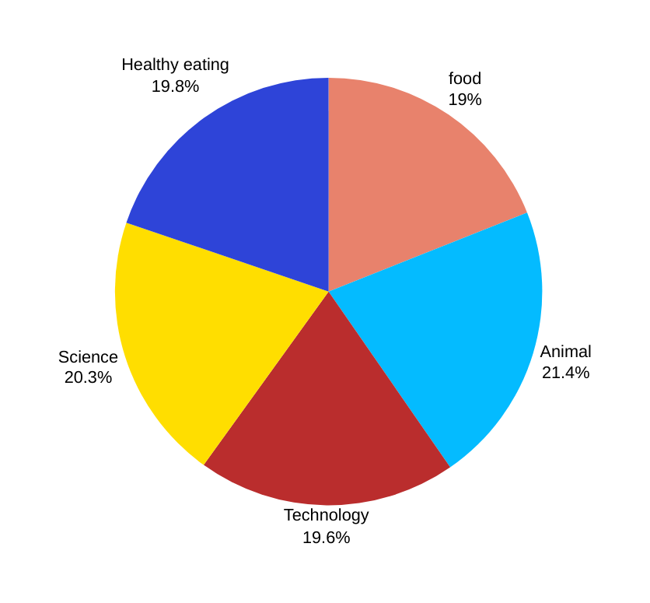

popularity percentage share from top 5 categories.

Slide 9
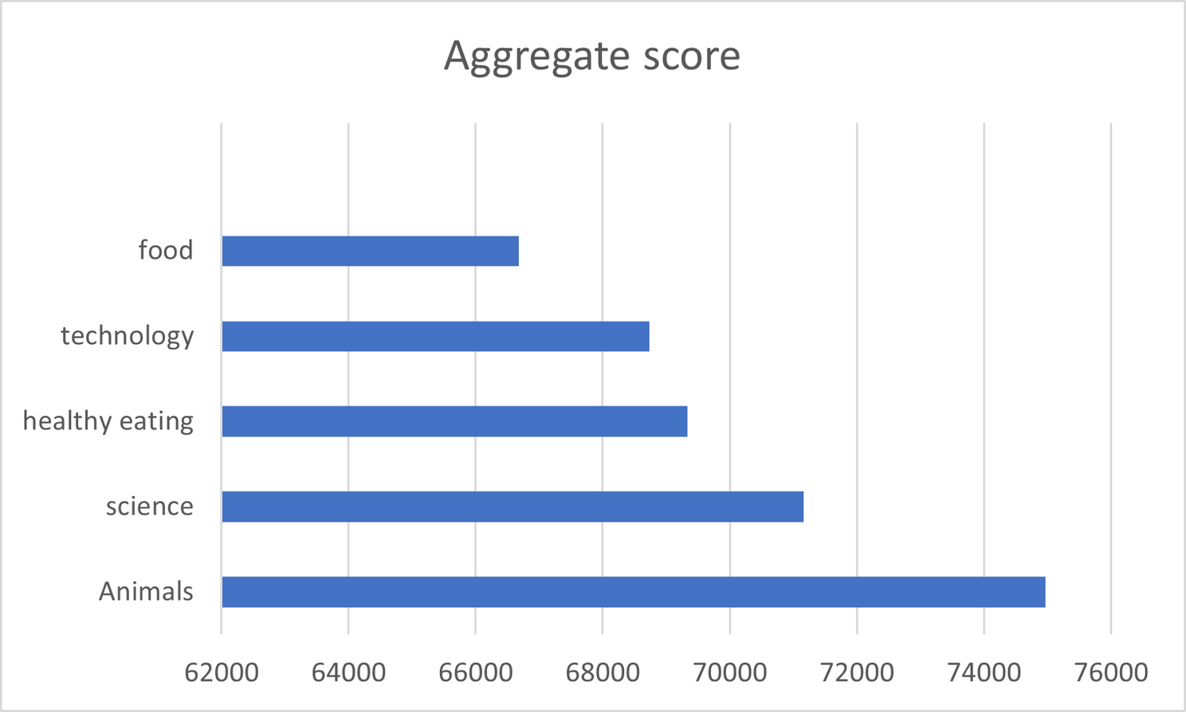
Top 5 Categories by aggregate “Popularity” score
Categories
Aggregate “Popularity” Score

Slide 10


ANALYSIS
Animals and science are the two most popular categories of content, showing that people enjoy "real-life" and "factual" content the most.
INSIGHT
Food is a common theme with the top 5 categories with "Healthy Eating" ranking the highest. This may give an indication to the audience within your user base. You could use this insight to create a campaign and work with healthy eating brands to boost user engagement.
NEXT STEPS
This ad-hoc analysis is insightful, but it's time to take this analysis into large scale production for real-time understanding of your business. We can show you how to do this.
Summary

Slide 11

Thank you!
ANY QUESTIONS?

